Slide 1
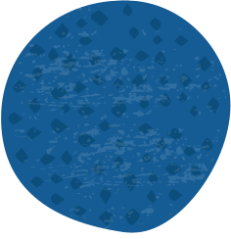




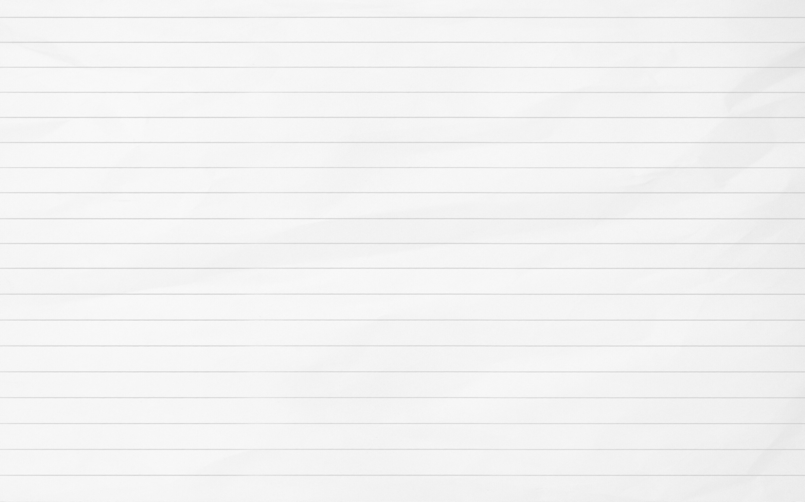
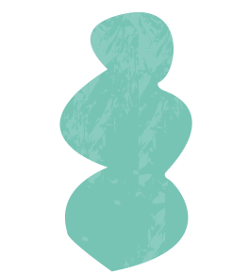



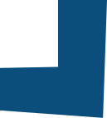



DOG DISEASE DETECTION
AYUSH SHARMA-23074008-CSE(IDD)
RIYA - 23075067 - CSE(B.TECH)

Slide 2
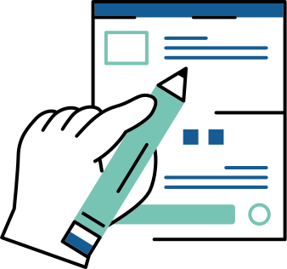
INTRODUCTION & PROBLEM STATEMENT
What is the problem?
Many dog owners struggle to detect early symptoms of diseases.
Veterinary check-ups may not always be accessible or affordable.
Why is this important?
Early diagnosis can prevent severe health issues.
AI-based solutions can assist pet owners with quick insights.

Slide 3
PROJECT GOAL
Main Objective:
Develop an Android app that detects diseases in dogs based on uploaded images and provides suggestions.
Key Features:
Image upload
Disease detection for eyes, paws, and skin
Suggestive feedback for users

Slide 4
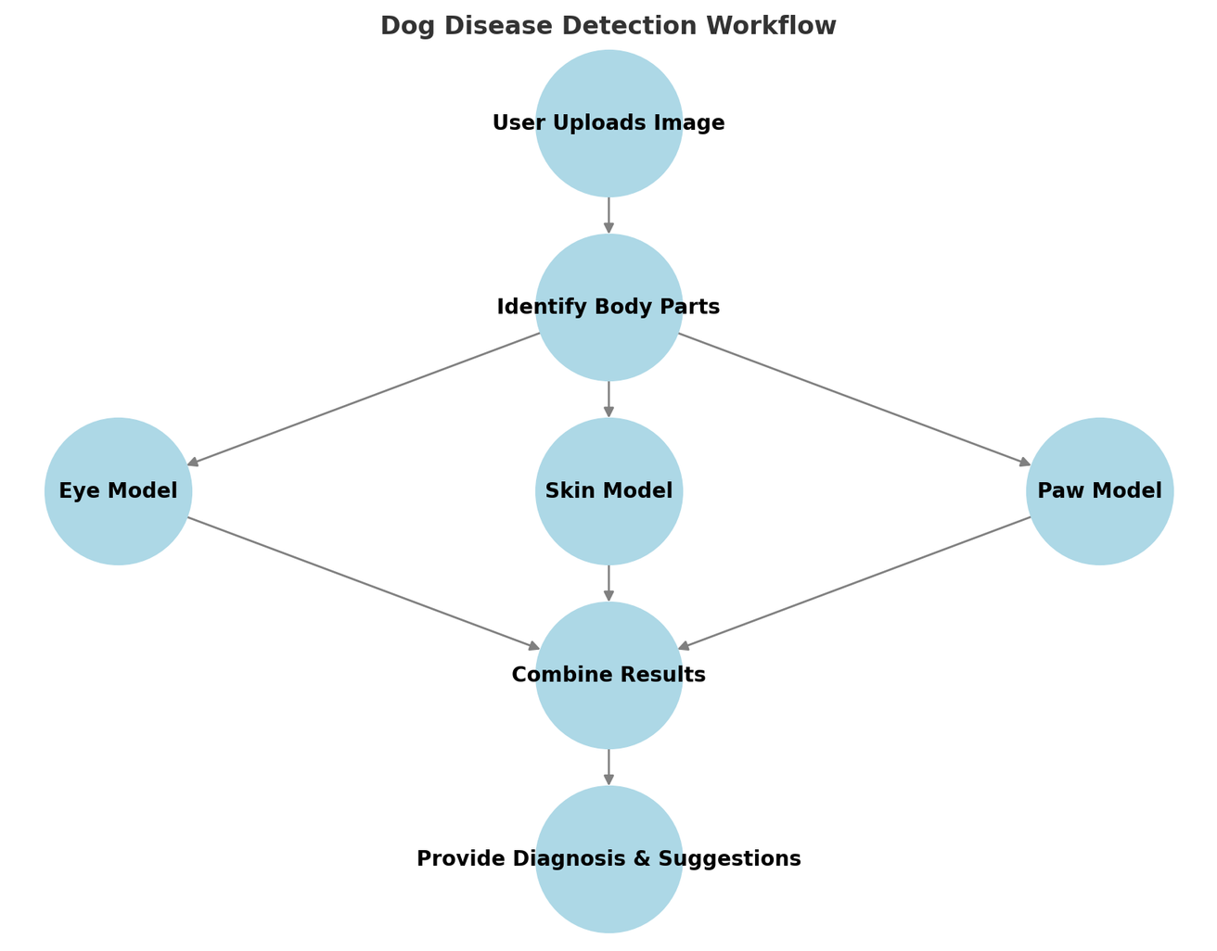
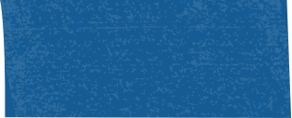


OVERALL WORKFLOW
Image Upload (User uploads an image of the dog)
Preprocessing (Identify relevant body part: Eyes, Paws, or Skin)
Disease Detection (Pass the part through specialized models)
Diagnosis & Suggestions (Provide results to the user)
Recommendation (Suggest possible next steps like consulting a vet)

Slide 5
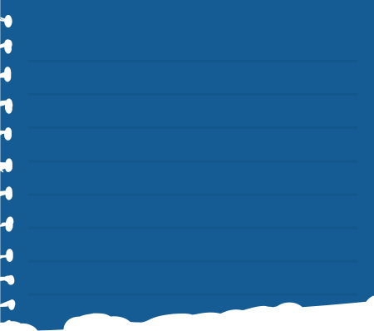
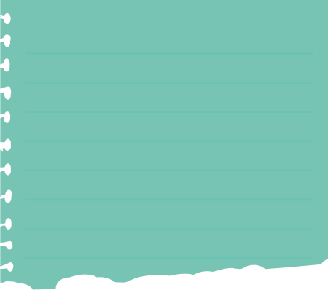
DATASET & PREPROCESSING
DATASET USED:
PREPROCESSING STEPS:
Stanford Dogs Dataset (for dog identification)
Dog Eye Segmentation 4-Class Ophthalmic Disease Dataset
https://www.kaggle.com/datasets/diemhuongnt12/dog-diseases-9class
https://www.kaggle.com/datasets/yashmotiani/dogs-skin-disease-dataset
https://www.kaggle.com/datasets/diemhuongnt12/5-skin-dog-diseases
https://universe.roboflow.com/suryani/dogdisease/dataset/2
https://universe.roboflow.com/suryani/pyoderma/dataset/1
https://universe.roboflow.com/tain/dog-leprosy/dataset/4
https://universe.roboflow.com/tain/ear-mites/dataset/2
For YOLO (Dog Identification):
Bounding box annotations
Resizing images
For Disease Models:
Segmentation to isolate eyes, paws, or skin
Data augmentation

Slide 6
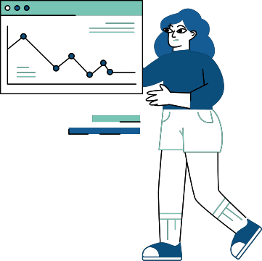
MODEL SELECTION & TRAINING
Dog Identification:
YOLOv8 trained to detect dogs in images
Disease Detection Models for Future Implementation:
Eye Diseases: U-Net + EfficientNet backbone (as per research paper)
Skin Diseases: Custom CNN, VGG16 (as per research paper)
Paw Diseases: Tiny YOLOv7 and Faster R - CNN (as per research paper)

Slide 7
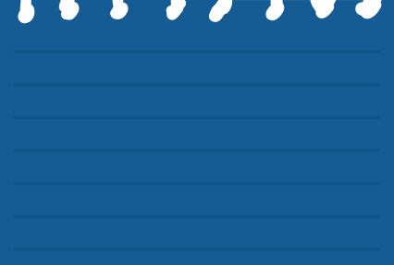

PROGRESS
✅
✅
✅
Literature
review
Dataset
Finalized
YOLO Model for Dog Identification Setup
✅
🔄
🔄
Developed a Mobile app and integrated YOLO Model with it,
UNet architecture for eye symptoms detection.
ResNet50 architecture for skin disease detection.

Slide 8
YOLO FOR DOG DETECTION
What is YOLO?
YOLO (You Only Look Once) is a state-of-the-art object detection algorithm known for its speed and accuracy. Unlike traditional methods, YOLO processes an image in a single pass through a neural network, making it highly efficient for real-time applications.
Why did we use YOLO for Dog Detection?
Fast & Efficient: Processes images in real-time.
High Accuracy: Detects dogs even in complex backgrounds.
Single-Pass Detection: Analyzes the entire image in one go, improving speed.
Versatile: Can be fine-tuned for detecting specific objects like organs in future steps.

Slide 9
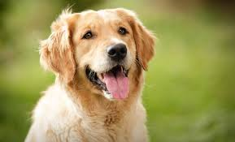
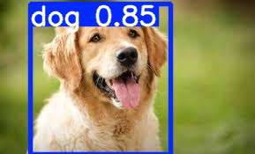
YOLO PERFORMANCE
Performance on different matrices:
Class: "all" indicates that these metrics are averaged over all detected classes.
Images: 20579 refers to the total number of images used in evaluation.
Instances: 22125 indicates the total number of object instances (bounding boxes) across all images.
P (Precision): 0.953 (or 95.3%) measures how many of the detected objects are actually correct (i.e., TP / (TP + FP)).
R (Recall): 0.959 (or 95.9%) measures how many of the actual objects were correctly detected (i.e., TP / (TP + FN)).

Slide 10
UNET ARCHITECTURE FOR IMAGE SEGMENTATION
What is UNet?
U-Net is a convolutional neural network (CNN) designed for image segmentation.
Originally proposed for biomedical image segmentation (Ronneberger et al., 2015).
Uses an encoder-decoder structure with skip connections for precise localization.
Why U-Net for This Project?
Efficient in segmenting small, detailed structures.
Works well with limited training data.
Skip connections help retain spatial information.
Already proven effective in medical and animal disease detection

Slide 11
OVERVIEW
DATASET PREPARATION
CUSTOMIZATION
Backbone Choice: EfficientNet B3
Weighted Cross-Entropy Loss: commonly used when dealing with class imbalance.
Contrast Limited Adaptive Histogram Equalization (CLAHE): image processing technique used to improve contrast in images.
Problem: Inconsistent Mask Labels
Dataset contained more than 5 expected classes causing inconsistency.
Solution: K-Nearest Neighbors (KNN) for Pixel Classification
A non-parametric classification algorithm that assigns labels based on majority class of its nearest neigbours.

Slide 12
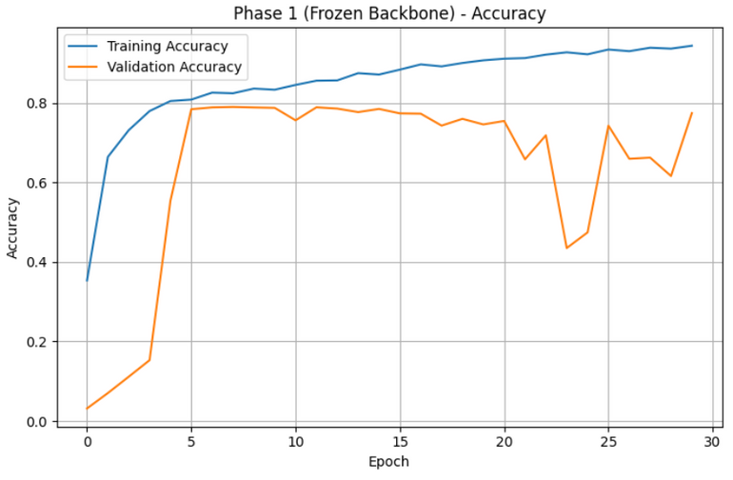
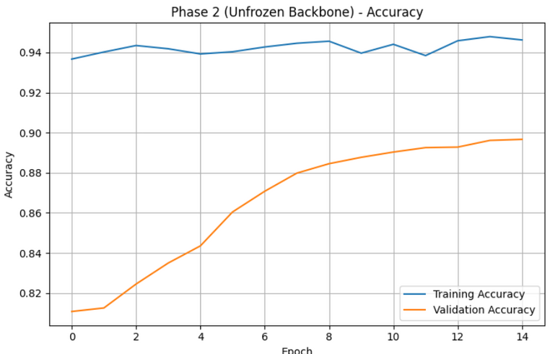
UNET ARCHITECTURE PERFORMANCE
Validation loss: 0.2814
Validation accuracy: 0.8967

Slide 13
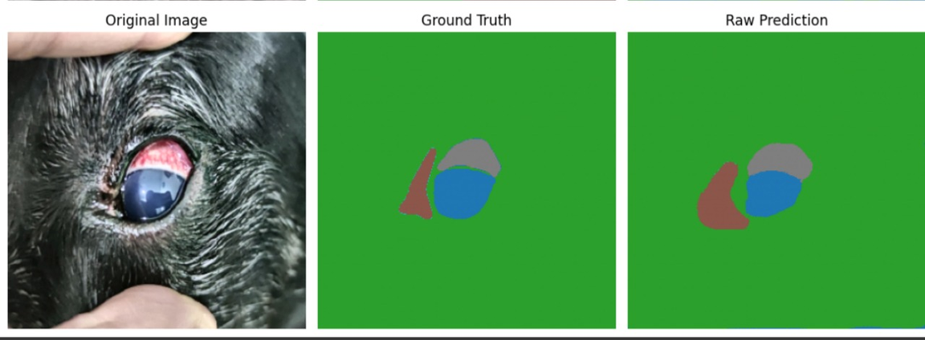
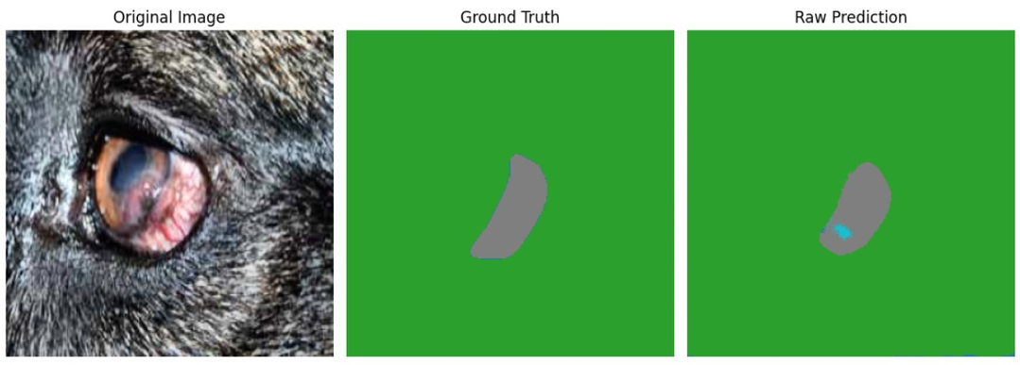
UNET ARCHITECTURE PERFORMANCE

Slide 14
FUTURE WORKS ANS IMPROVEMENTS
Enhancing U-Net and Symptom Prediction:
Improve the U-Net model to not just segment regions but also predict possible symptoms directly.
Integrate feature extraction methods to identify patterns associated with specific diseases.
Expanding Disease Detection
Skin Disease Model: Work is already underway to classify different skin conditions in dogs.
Paw Disease Detection: We will soon begin developing a dedicated model for paw-related symptoms, ensuring a more comprehensive diagnostic system.

Slide 15
APP DEVELOPMENT
TECH STACK
FEATURES
Frontend: React Native with Expo framework for cross-platform mobile development.
Backend: FastAPI for handling API requests and processing images.
Other Tools: OpenCV for image processing and TensorFlow/PyTorch for model deployment.
Image Upload: Users can upload images from their gallery.
Flip & Crop Image: Basic image editing features allow users to modify images before detection.
Object Detection using YOLO: The app processes the image and highlights detected objects.
User-friendly Interface: Simple and intuitive UI for seamless interaction.

Slide 16
WORKFLOW
User uploads an image in the mobile app.
The image is preprocessed and sent to the FastAPI backend.
The backend forwards the image to the YOLO model for detection.
Detected objects are annotated on the image and sent back to the mobile app.
The app displays the results to the user.

Slide 17
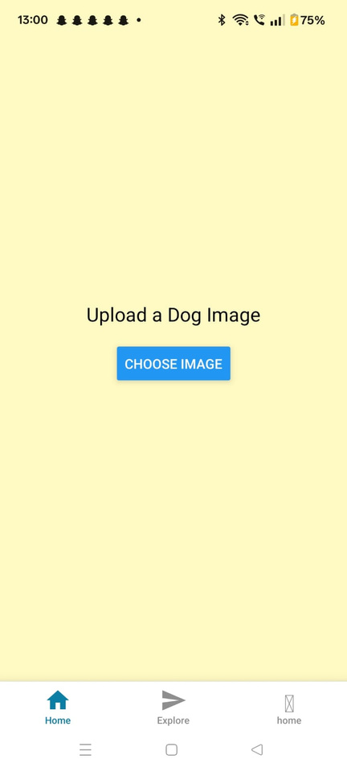
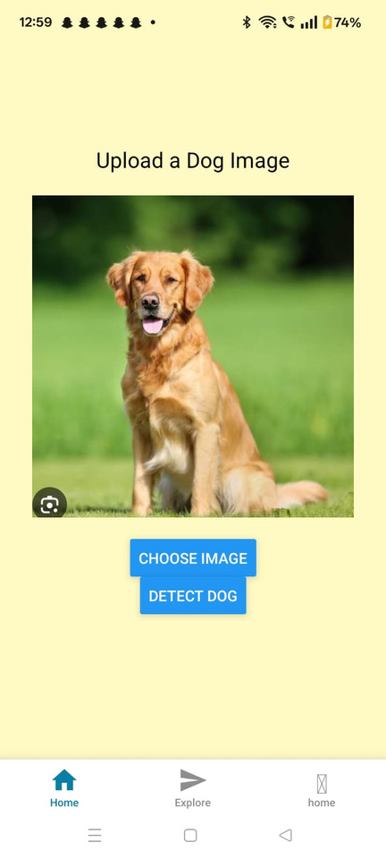
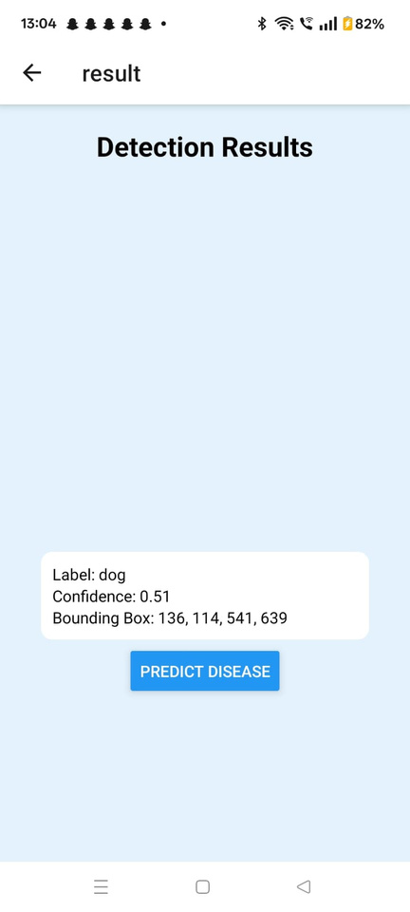
SCREENSHOTS OF THE APP

Slide 18
FUTURE WORK
Integrate disease prediction models to extend the app’s functionality for medical diagnosis.
Deploy the app on cloud to ensure scalability and accessibility.
Enhance user interface by adding real-time camera-based object detection.

Slide 19
THANK YOU

